Slide 1
텐서플로와 머신러닝으로 시작하는
자연어처리
Lecture 6

Slide 2
Attention?!

Slide 3
Attention?!
What is Attention Mechanism
Why do we need Attention
Papers
Neural Machine Translation by Jointly Learning to Align and Translate
Various Attention Mechanism
Another methods to enrich NMT performance

Slide 4
What is Attention

Slide 5
What is Attention Mechanism

Slide 6
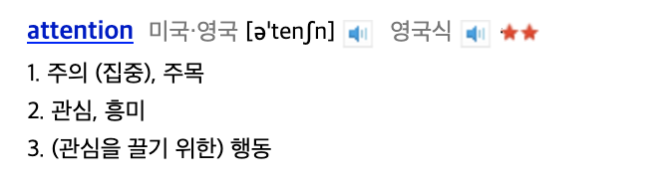
What is Attention Mechanism

Slide 7
What is Attention Mechanism

Slide 8
What is Attention Mechanism
주어진 목적에 맞는 Source에 집중

Slide 9
What is Attention Mechanism
주어진 목적에 맞는 Source에 집중

Slide 10
What is Attention Mechanism
주어진 목적에 맞는 Source에 집중
ex) 감정 분석 Task

Slide 11
What is Attention Mechanism
주어진 목적에 맞는 Source에 집중
ex) 감정 분석 Task
Input: 이 영화는 감독이 진짜 잘 만든 영화인 것 같다.

Slide 12
What is Attention Mechanism
주어진 목적에 맞는 Source에 집중
ex) 감정 분석 Task
Input: 이 영화는 감독이 진짜 잘 만든 영화인 것 같다.
Output: ?

Slide 13
What is Attention Mechanism
주어진 목적에 맞는 Source에 집중
ex) 감정 분석 Task
Input: 이 영화는 감독이 진짜 잘 만든 영화인 것 같다.
Output: ?

Slide 14
What is Attention Mechanism
주어진 목적에 맞는 Source에 집중
ex) 감정 분석 Task
Input: 이 영화는 감독이 진짜 잘 만든 영화인 것 같다.
Output: ?

Slide 15
What is Attention
What is Attention Mechanism
주어진 목적에 맞는 Source에 집중
ex) 감정 분석 Task
Input: 이 영화는 감독이 진짜 잘 만든 영화인 것 같다.
Output: 긍정

Slide 16
What is Attention Mechanism
주어진 목적에 맞는 Source에 집중

Slide 17
What is Attention Mechanism
주어진 목적에 맞는 Source에 집중
Image Classification

Slide 18
What is Attention Mechanism
주어진 목적에 맞는 Source에 집중
개? 고양이?
Image Classification

Slide 19
What is Attention Mechanism
개, 고양이 구분
주어진 목적에 맞는 Source에 집중
개? 고양이?
Image Classification

Slide 20
What is Attention Mechanism
개, 고양이 구분
각 픽셀값
주어진 목적에 맞는 Source에 집중
개? 고양이?
Image Classification

Slide 21
What is Attention Mechanism
주어진 목적에 맞는 Source에 집중
개? 고양이?
Image Classification

Slide 22
What is Attention Mechanism
주어진 목적에 맞는 Source에 집중
개? 고양이!
Image Classification

Slide 23
Why do we need Attention

Slide 24
Why do we need Attention
Limitation of Sequence to Sequence Model

Slide 25
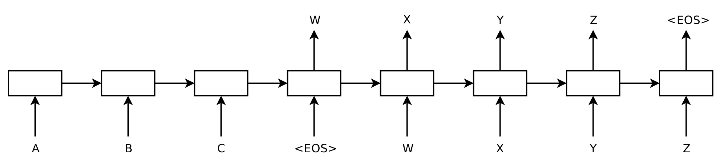
Why do we need Attention
Limitation of Sequence to Sequence Model

Slide 26
Why do we need Attention
Limitation of Sequence to Sequence Model
모든 Input Sequence의 정보를 하나의 fixed-size vector에 압축해서 담고있음

Slide 27
Why do we need Attention
Limitation of Sequence to Sequence Model
모든 Input Sequence의 정보를 하나의 fixed-size vector에 압축해서 담고있음

Slide 28
Why do we need Attention
Limitation of Sequence to Sequence Model
Input
The Sequence to Sequence model is good
모든 Input Sequence의 정보를 하나의 fixed-size vector에 압축해서 담고있음

Slide 29
Why do we need Attention
Limitation of Sequence to Sequence Model
Input
The Sequence to Sequence model is good
모든 Input Sequence의 정보를 하나의 fixed-size vector에 압축해서 담고있음

Slide 30
Why do we need Attention
Limitation of Sequence to Sequence Model
Input
The Sequence to Sequence which is made by Cho et al. at NYU University model is good for Machine Translation
모든 Input Sequence의 정보를 하나의 fixed-size vector에 압축해서 담고있음

Slide 31
Why do we need Attention
Limitation of Sequence to Sequence Model
Input
The Sequence to Sequence which is made by Cho et al. at NYU University model is good for Machine Translation
모든 Input Sequence의 정보를 하나의 fixed-size vector에 압축해서 담고있음

Slide 32
Why do we need Attention
Limitation of Sequence to Sequence Model
Input
The Sequence to Sequence which is
…
…
model is good for Machine Translation
모든 Input Sequence의 정보를 하나의 fixed-size vector에 압축해서 담고있음

Slide 33
Why do we need Attention
Limitation of Sequence to Sequence Model
Input
The Sequence to Sequence which is
…
…
model is good for Machine Translation
모든 Input Sequence의 정보를 하나의 fixed-size vector에 압축해서 담고있음

Slide 34
Why do we need Attention
Limitation of Sequence to Sequence Model
모든 Input Sequence의 정보를 하나의 fixed-size vector에 압축해서 담고있음
문장이 길어질수록 전체 정보를 하나의 벡터로 표현하기 어려워짐

Slide 35
Why do we need Attention
Limitation of Sequence to Sequence Model
모든 Input Sequence의 정보를 하나의 fixed-size vector에 압축해서 담고있음

Slide 36
Why do we need Attention
Limitation of Sequence to Sequence Model
모든 Input Sequence의 정보를 하나의 fixed-size vector에 압축해서 담고있음

Slide 37
Why do we need Attention
Limitation of Sequence to Sequence Model
모든 Input Sequence의 정보를 하나의 fixed-size vector에 압축해서 담고있음
문장 초기 Step의 정보는 마지막 Step에 비해 상대적으로 덜 사용됨

Slide 38
Why do we need Attention
Limitation of Sequence to Sequence Model
문장이 길어질수록 전체 정보를 하나의 벡터로 표현하기 어려워짐
문장 초기 Step의 정보는 마지막 Step에 비해 상대적으로 덜 사용됨

Slide 39
Why do we need Attention
Limitation of Sequence to Sequence Model
문장이 길어질수록 전체 정보를 하나의 벡터로 표현하기 어려워짐
문장 초기 Step의 정보는 마지막 Step에 비해 상대적으로 덜 사용됨
Neural Machine Translation by Jointly Learning to Align And Translate

Slide 40
Why do we need Attention
Limitation of Sequence to Sequence Model
문장이 길어질수록 전체 정보를 하나의 벡터로 표현하기 어려워짐
문장 초기 Step의 정보는 마지막 Step에 비해 상대적으로 덜 사용됨
a.k.a Sequence to Sequence with Attention

Slide 41
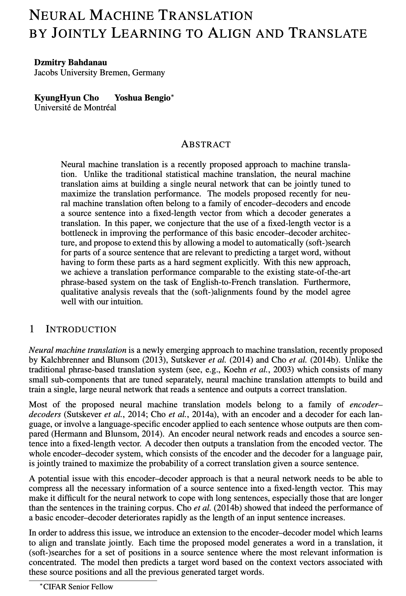
Neural Machine Translation By Jointly Learning To Align And Translate
Bahdanau et al. (2016)
Attention Mechanism을 처음 도입
Bidirectional RNN을 사용함

Slide 42
Neural Machine Translation By Jointly Learning To Align And Translate
문장이 길어질수록 전체 정보를 하나의 벡터로 표현하기 어려워짐
문장 초기 Step의 정보는 마지막 Step에 비해 상대적으로 덜 사용됨

Slide 43
Neural Machine Translation By Jointly Learning To Align And Translate
문장이 길어질수록 전체 정보를 하나의 벡터로 표현하기 어려워짐
문장 초기 Step의 정보는 마지막 Step에 비해 상대적으로 덜 사용됨
Attention Mechanism (alignment model)
Bidirectional RNN

Slide 44
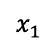
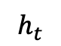
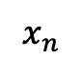
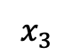
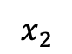
Neural Machine Translation By Jointly Learning To Align And Translate
Bidirectional RNN
$$h_{t}$$
RNN
RNN
RNN
⋯
RNN
$$x_{1}$$
$$x_{2}$$
$$x_{3}$$
$$x_{n}$$
기존 Unidirectional RNN

Slide 45
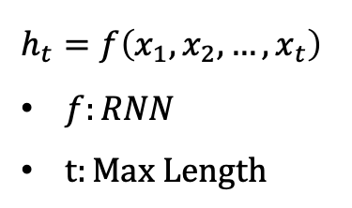
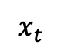
Neural Machine Translation By Jointly Learning To Align And Translate
Bidirectional RNN
$$h_{t}=f\left(x_{1},x_{2}, …, x_{t}\right)$$
$f:RNN$
$t:Max Length$
$$h_{t}$$
RNN
RNN
RNN
⋯
RNN
$$x_{1}$$
$$x_{2}$$
$$x_{3}$$
$$x_{t}$$
기존 Unidirectional RNN

Slide 46
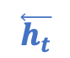
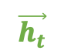
Neural Machine Translation By Jointly Learning To Align And Translate
Bidirectional RNN
$$\overset{⃖}{h_{t}}$$
$$\vec{h_{t}}$$
RNN
RNN
RNN
RNN
RNN
RNN
RNN
⋯
RNN
$$x_{1}$$
$$x_{2}$$
$$x_{3}$$
$$x_{n}$$
Bidirectional RNN

Slide 47
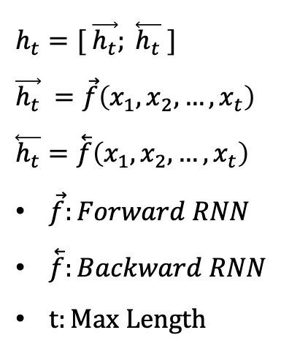
Neural Machine Translation By Jointly Learning To Align And Translate
Bidirectional RNN
$$\overset{⃖}{h_{t}}$$
$$\vec{h_{t}}$$
$$h_{t}=[ \vec{h_{t}}; \overset{⃖}{h_{t}} ]$$
$$\vec{h_{t}} =\vec{f}\left(x_{1},x_{2}, …, x_{t}\right)$$
$$\overset{⃖}{h_{t}}=\overset{⃖}{f}\left(x_{1},x_{2}, …, x_{t}\right)$$
$\vec{f}:Forward RNN$
$\overset{⃖}{f}:Backward RNN$
$t:Max Length$
RNN
RNN
RNN
RNN
RNN
RNN
RNN
⋯
RNN
$$x_{1}$$
$$x_{2}$$
$$x_{3}$$
$$x_{n}$$
Bidirectional RNN

Slide 48
Neural Machine Translation By Jointly Learning To Align And Translate
Attention Mechanism (alignment model)

Slide 49
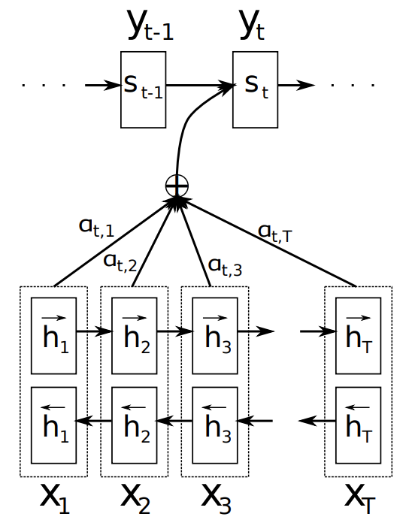
Neural Machine Translation By Jointly Learning To Align And Translate
Attention Mechanism (alignment model)

Slide 50
Neural Machine Translation By Jointly Learning To Align And Translate
Attention Mechanism (alignment model)

Slide 51
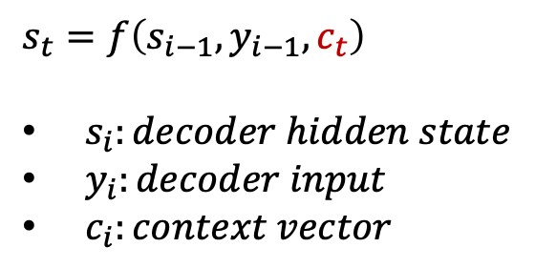
Neural Machine Translation By Jointly Learning To Align And Translate
Attention Mechanism (alignment model)
$$s_{t}=f\left(s_{i−1}, y_{i−1},c_{t}\right)$$
${ s}_{i}:decoder hidden state$
$y_{i}:decoder input$
$c_{i}:context vector$

Slide 52
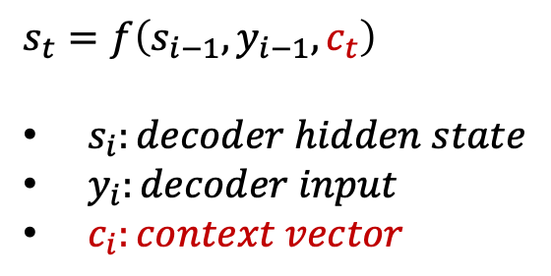
Neural Machine Translation By Jointly Learning To Align And Translate
Attention Mechanism (alignment model)
$$s_{t}=f\left(s_{i−1}, y_{i−1},c_{t}\right)$$
${ s}_{i}:decoder hidden state$
${ y}_{i}:decoder input$
$c_{i}:context vector$

Slide 53
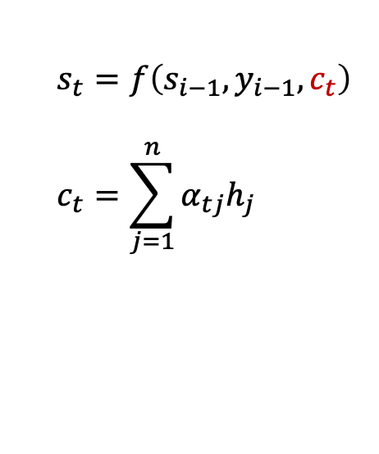
Neural Machine Translation By Jointly Learning To Align And Translate
Attention Mechanism (alignment model)
$$s_{t}=f\left(s_{i−1}, y_{i−1},c_{t}\right)$$
$$c_{t}=\sum_{j=1}^{n}{α_{tj}h_{j}}$$

Slide 54
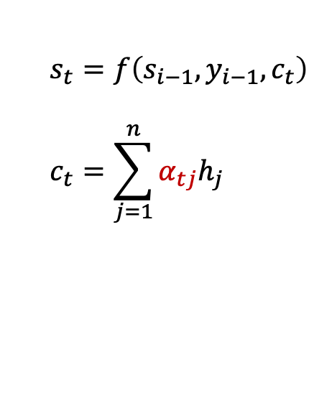
Neural Machine Translation By Jointly Learning To Align And Translate
Attention Mechanism (alignment model)
$$s_{t}=f\left(s_{i−1}, y_{i−1},c_{t}\right)$$
$$c_{t}=\sum_{j=1}^{n}{α_{tj}h_{j}}$$

Slide 55
Neural Machine Translation By Jointly Learning To Align And Translate
Attention Mechanism (alignment model)
$$s_{t}=f\left(s_{i−1}, y_{i−1},c_{t}\right)$$
$$c_{t}=\sum_{j=1}^{n}{α_{tj}h_{j}}$$
attention weight

Slide 56
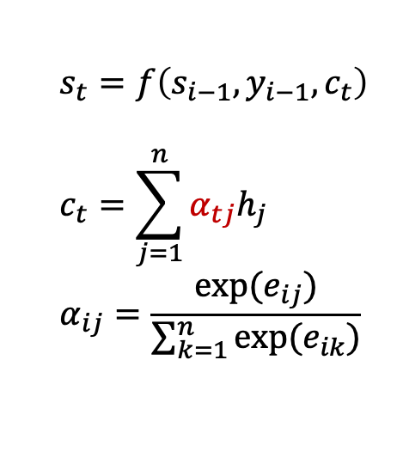
Neural Machine Translation By Jointly Learning To Align And Translate
Attention Mechanism (alignment model)
$$s_{t}=f\left(s_{i−1}, y_{i−1},c_{t}\right)$$
$$c_{t}=\sum_{j=1}^{n}{α_{tj}h_{j}}$$
$$α_{ij}=\frac{exp⁡(e_{ij})}{\sum_{k=1}^{n}{exp⁡(e_{ik})}}$$

Slide 57
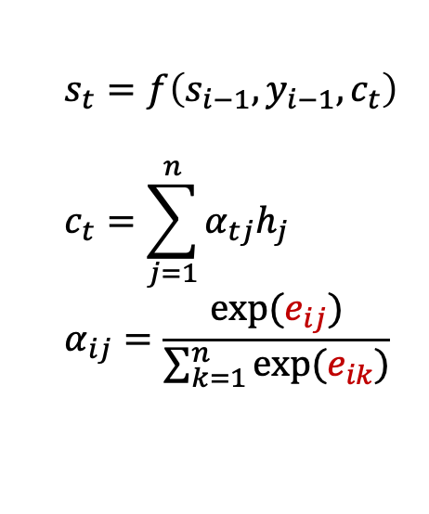
Neural Machine Translation By Jointly Learning To Align And Translate
Attention Mechanism (alignment model)
$$s_{t}=f\left(s_{i−1}, y_{i−1},c_{t}\right)$$
$$c_{t}=\sum_{j=1}^{n}{α_{tj}h_{j}}$$
$$α_{ij}=\frac{exp⁡(e_{ij})}{\sum_{k=1}^{n}{exp⁡(e_{ik})}}$$

Slide 58
Neural Machine Translation By Jointly Learning To Align And Translate
Attention Mechanism (alignment model)
$$s_{t}=f\left(s_{i−1}, y_{i−1},c_{t}\right)$$
$$c_{t}=\sum_{j=1}^{n}{α_{tj}h_{j}}$$
$$α_{ij}=\frac{exp⁡(e_{ij})}{\sum_{k=1}^{n}{exp⁡(e_{ik})}}$$
attention score(energy)

Slide 59
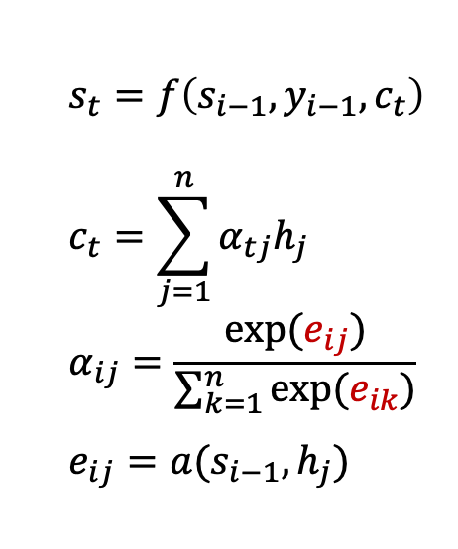
Neural Machine Translation By Jointly Learning To Align And Translate
Attention Mechanism (alignment model)
$$s_{t}=f\left(s_{i−1}, y_{i−1},c_{t}\right)$$
$$c_{t}=\sum_{j=1}^{n}{α_{tj}h_{j}}$$
$$α_{ij}=\frac{exp⁡(e_{ij})}{\sum_{k=1}^{n}{exp⁡(e_{ik})}}$$
$$e_{ij}=a(s_{i−1},h_{j})$$

Slide 60
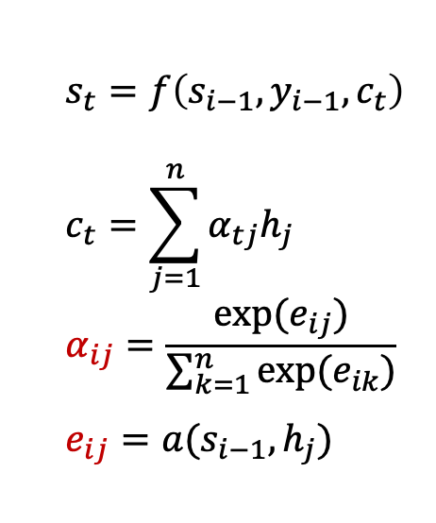
Neural Machine Translation By Jointly Learning To Align And Translate
Attention Mechanism (alignment model)
$$s_{t}=f\left(s_{i−1}, y_{i−1},c_{t}\right)$$
$$c_{t}=\sum_{j=1}^{n}{α_{tj}h_{j}}$$
$$α_{ij}=\frac{exp⁡(e_{ij})}{\sum_{k=1}^{n}{exp⁡(e_{ik})}}$$
$$e_{ij}=a(s_{i−1},h_{j})$$

Slide 61

Neural Machine Translation By Jointly Learning To Align And Translate
Attention Mechanism (alignment model)
$$s_{t}=f\left(s_{i−1}, y_{i−1},c_{t}\right)$$
$$c_{t}=\sum_{j=1}^{n}{α_{tj}h_{j}}$$
$$α_{ij}=\frac{exp⁡(e_{ij})}{\sum_{k=1}^{n}{exp⁡(e_{ik})}}$$
$$e_{ij}=a(s_{i−1},h_{j})$$
$j$번째 input을 $i$번째 output에
얼마나 반영할지 나타내는 중요도

Slide 62

Neural Machine Translation By Jointly Learning To Align And Translate
Attention Mechanism (alignment model)
$$s_{t}=f\left(s_{i−1}, y_{i−1},c_{t}\right)$$
$$c_{t}=\sum_{j=1}^{n}{α_{tj}h_{j}}$$
$$α_{ij}=\frac{exp⁡(e_{ij})}{\sum_{k=1}^{n}{exp⁡(e_{ik})}}$$
$$e_{ij}=a(s_{i−1},h_{j})$$
$j$번째 input을 $i$번째 output에
얼마나 반영할지 나타내는 확률
$j$번째 input을 $i$번째 output에
얼마나 반영할지 나타내는 중요도

Slide 63


Neural Machine Translation By Jointly Learning To Align And Translate
Attention Mechanism (alignment model)
$$s_{t}=f\left(s_{i−1}, y_{i−1},c_{t}\right)$$
$$c_{t}=\sum_{j=1}^{n}{α_{tj}h_{j}}$$
$$α_{ij}=\frac{exp⁡(e_{ij})}{\sum_{k=1}^{n}{exp⁡(e_{ik})}}$$
$$e_{ij}=a(s_{i−1},h_{j})$$
$j$번째 input을 $i$번째 output에
얼마나 반영할지 나타내는 확률
$j$번째 input을 $i$번째 output에
얼마나 반영할지 나타내는 중요도

Slide 64
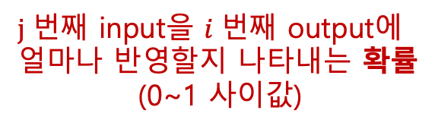
Neural Machine Translation By Jointly Learning To Align And Translate
Attention Mechanism (alignment model)
$$s_{t}=f\left(s_{i−1}, y_{i−1},c_{t}\right)$$
$$c_{t}=\sum_{j=1}^{n}{α_{tj}h_{j}}$$
$$α_{ij}=\frac{exp⁡(e_{ij})}{\sum_{k=1}^{n}{exp⁡(e_{ik})}}$$
$$e_{ij}=a(s_{i−1},h_{j})$$
$j$번째 input을 $i$번째 output에
얼마나 반영할지 나타내는 확률
(0~1 사이값)
$j$번째 input을 $i$번째 output에
얼마나 반영할지 나타내는 중요도

Slide 65
Neural Machine Translation By Jointly Learning To Align And Translate
Attention Mechanism (alignment model)
$$s_{t}=f\left(s_{i−1}, y_{i−1},c_{t}\right)$$
$$c_{t}=\sum_{j=1}^{n}{α_{tj}h_{j}}$$
$$α_{ij}=\frac{exp⁡(e_{ij})}{\sum_{k=1}^{n}{exp⁡(e_{ik})}}$$
$$e_{ij}=a(s_{i−1},h_{j})$$
$j$번째 input을 $i$번째 output에
얼마나 반영할지 나타내는 확률
$j$번째 input을 $i$번째 output에
얼마나 반영할지 나타내는 중요도

Slide 66
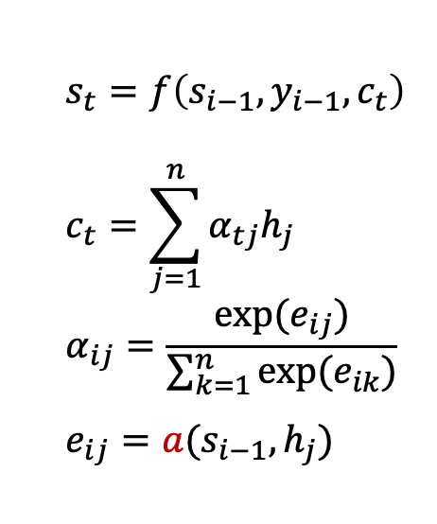
Neural Machine Translation By Jointly Learning To Align And Translate
Attention Mechanism (alignment model)
$$s_{t}=f\left(s_{i−1}, y_{i−1},c_{t}\right)$$
$$c_{t}=\sum_{j=1}^{n}{α_{tj}h_{j}}$$
$$α_{ij}=\frac{exp⁡(e_{ij})}{\sum_{k=1}^{n}{exp⁡(e_{ik})}}$$
$$e_{ij}=a(s_{i−1},h_{j})$$

Slide 67
Neural Machine Translation By Jointly Learning To Align And Translate
Attention Mechanism (alignment model)
$$s_{t}=f\left(s_{i−1}, y_{i−1},c_{t}\right)$$
$$c_{t}=\sum_{j=1}^{n}{α_{tj}h_{j}}$$
$$α_{ij}=\frac{exp⁡(e_{ij})}{\sum_{k=1}^{n}{exp⁡(e_{ik})}}$$
$$e_{ij}=a(s_{i−1},h_{j})$$
how to calculate attention score?

Slide 68
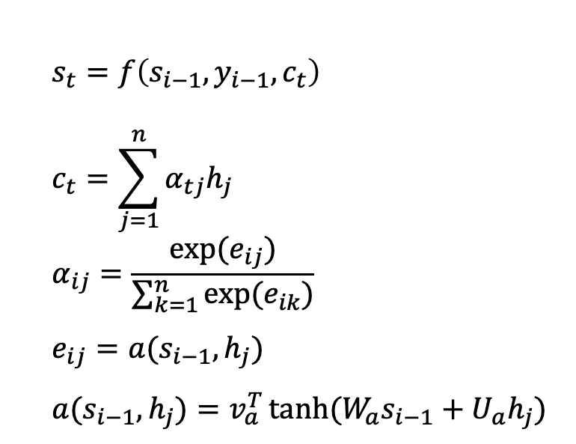
Neural Machine Translation By Jointly Learning To Align And Translate
Attention Mechanism (alignment model)
$$s_{t}=f\left(s_{i−1}, y_{i−1},c_{t}\right)$$
$$c_{t}=\sum_{j=1}^{n}{α_{tj}h_{j}}$$
$$α_{ij}=\frac{exp⁡(e_{ij})}{\sum_{k=1}^{n}{exp⁡(e_{ik})}}$$
$$e_{ij}=a(s_{i−1},h_{j})$$
$$a(s_{i−1},h_{j})=v_{a}^{T}\tanh{(W_{a}s_{i−1}+U_{a}h_{j})}$$

Slide 69
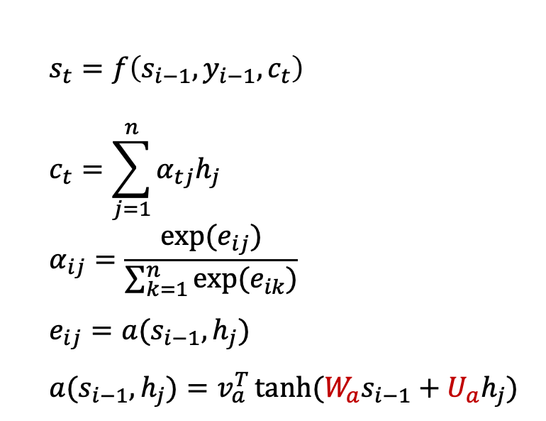
Neural Machine Translation By Jointly Learning To Align And Translate
Attention Mechanism (alignment model)
$$s_{t}=f\left(s_{i−1}, y_{i−1},c_{t}\right)$$
$$c_{t}=\sum_{j=1}^{n}{α_{tj}h_{j}}$$
$$α_{ij}=\frac{exp⁡(e_{ij})}{\sum_{k=1}^{n}{exp⁡(e_{ik})}}$$
$$e_{ij}=a(s_{i−1},h_{j})$$
$$a(s_{i−1},h_{j})=v_{a}^{T}\tanh{(W_{a}s_{i−1}+U_{a}h_{j})}$$
Weight matrix

Slide 70
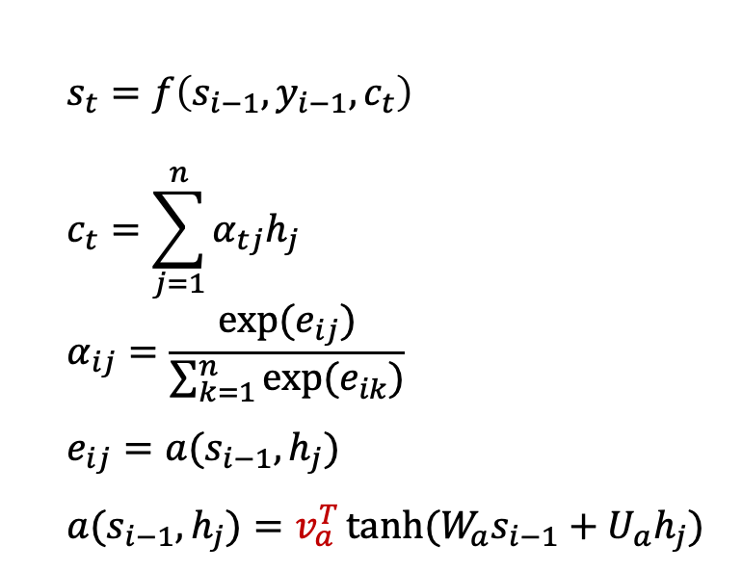
Neural Machine Translation By Jointly Learning To Align And Translate
Attention Mechanism (alignment model)
$$s_{t}=f\left(s_{i−1}, y_{i−1},c_{t}\right)$$
$$c_{t}=\sum_{j=1}^{n}{α_{tj}h_{j}}$$
$$α_{ij}=\frac{exp⁡(e_{ij})}{\sum_{k=1}^{n}{exp⁡(e_{ik})}}$$
$$e_{ij}=a(s_{i−1},h_{j})$$
$$a(s_{i−1},h_{j})=v_{a}^{T}\tanh{(W_{a}s_{i−1}+U_{a}h_{j})}$$
Weight matrix

Slide 71
Neural Machine Translation By Jointly Learning To Align And Translate
Attention Mechanism (alignment model)
$$s_{t}=f\left(s_{i−1}, y_{i−1},c_{t}\right)$$
$$c_{t}=\sum_{j=1}^{n}{α_{tj}h_{j}}$$
$$α_{ij}=\frac{exp⁡(e_{ij})}{\sum_{k=1}^{n}{exp⁡(e_{ik})}}$$
$$e_{ij}=a(s_{i−1},h_{j})$$
$$a(s_{i−1},h_{j})=v_{a}^{T}\tanh{(W_{a}s_{i−1}+U_{a}h_{j})}$$
Weight matrix

Slide 72
Neural Machine Translation By Jointly Learning To Align And Translate
Attention Mechanism (alignment model)

Slide 73
Neural Machine Translation By Jointly Learning To Align And Translate
Attention Mechanism (alignment model)
Encoder

Slide 74
Neural Machine Translation By Jointly Learning To Align And Translate
Attention Mechanism (alignment model)
Encoder
1

Slide 75
Neural Machine Translation By Jointly Learning To Align And Translate
Attention Mechanism (alignment model)
Encoder
1
2

Slide 76
Neural Machine Translation By Jointly Learning To Align And Translate
Attention Mechanism (alignment model)
Encoder
1
2
3

Slide 77
Neural Machine Translation By Jointly Learning To Align And Translate
Attention Mechanism (alignment model)
Encoder
1
2
3
4

Slide 78
Neural Machine Translation By Jointly Learning To Align And Translate
Attention Mechanism (alignment model)
Encoder
1
2
3
4
5

Slide 79
Neural Machine Translation By Jointly Learning To Align And Translate
Attention Mechanism (alignment model)
Encoder
1
2
3
4
5

Slide 80
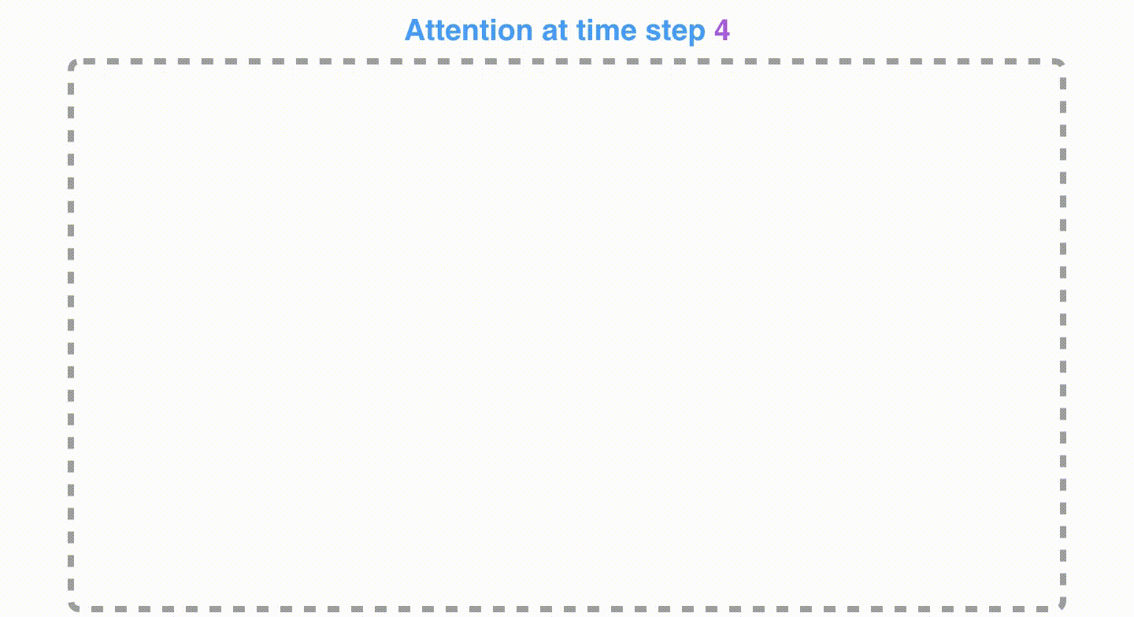
Neural Machine Translation By Jointly Learning To Align And Translate
Attention Mechanism (alignment model)

Slide 81
Various Attention Mechanism

Slide 82
Various Attention Mechanism

Slide 83

Various Attention Mechanism
$$s_{t}=f\left(s_{i−1}, y_{i−1},c_{t}\right)$$
$$c_{t}=\sum_{j=1}^{n}{α_{tj}h_{j}}$$
$$α_{ij}=\frac{exp⁡(e_{ij})}{\sum_{k=1}^{n}{exp⁡(e_{ik})}}$$
$$e_{ij}=a(s_{i−1},h_{j})$$

Slide 84
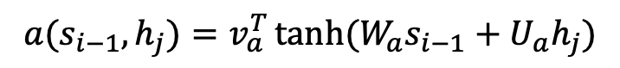
Various Attention Mechanism
$$s_{t}=f\left(s_{i−1}, y_{i−1},c_{t}\right)$$
$$c_{t}=\sum_{j=1}^{n}{α_{tj}h_{j}}$$
$$α_{ij}=\frac{exp⁡(e_{ij})}{\sum_{k=1}^{n}{exp⁡(e_{ik})}}$$
$$e_{ij}=a(s_{i−1},h_{j})$$
$$a(s_{i−1},h_{j})=v_{a}^{T}\tanh{(W_{a}s_{i−1}+U_{a}h_{j})}$$

Slide 85
Various Attention Mechanism
Additive Attention
$$s_{t}=f\left(s_{i−1}, y_{i−1},c_{t}\right)$$
$$c_{t}=\sum_{j=1}^{n}{α_{tj}h_{j}}$$
$$α_{ij}=\frac{exp⁡(e_{ij})}{\sum_{k=1}^{n}{exp⁡(e_{ik})}}$$
$$e_{ij}=a(s_{i−1},h_{j})$$
$$a(s_{i−1},h_{j})=v_{a}^{T}\tanh{(W_{a}s_{i−1}+U_{a}h_{j})}$$

Slide 86
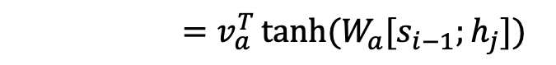
Various Attention Mechanism
Additive Attention
$$s_{t}=f\left(s_{i−1}, y_{i−1},c_{t}\right)$$
$$c_{t}=\sum_{j=1}^{n}{α_{tj}h_{j}}$$
$$α_{ij}=\frac{exp⁡(e_{ij})}{\sum_{k=1}^{n}{exp⁡(e_{ik})}}$$
$$e_{ij}=a(s_{i−1},h_{j})$$
$$a(s_{i−1},h_{j})=v_{a}^{T}\tanh{(W_{a}s_{i−1}+U_{a}h_{j})}$$
$=v_{a}^{T}\tanh{(W_{a}[s_{i−1};h_{j}])}$

Slide 87
Various Attention Mechanism
Dot-Product Attention
$$s_{t}=f\left(s_{i−1}, y_{i−1},c_{t}\right)$$
$$c_{t}=\sum_{j=1}^{n}{α_{tj}h_{j}}$$
$$α_{ij}=\frac{exp⁡(e_{ij})}{\sum_{k=1}^{n}{exp⁡(e_{ik})}}$$
$$e_{ij}=a(s_{i−1},h_{j})$$

Slide 88
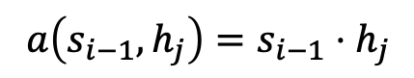
Various Attention Mechanism
Dot-Product Attention
$$s_{t}=f\left(s_{i−1}, y_{i−1},c_{t}\right)$$
$$c_{t}=\sum_{j=1}^{n}{α_{tj}h_{j}}$$
$$α_{ij}=\frac{exp⁡(e_{ij})}{\sum_{k=1}^{n}{exp⁡(e_{ik})}}$$
$$e_{ij}=a(s_{i−1},h_{j})$$
$$a\left(s_{i−1},h_{j}\right)=s_{i−1}⋅h_{j}$$

Slide 89
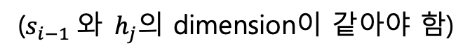
Various Attention Mechanism
Dot-Product Attention
$$s_{t}=f\left(s_{i−1}, y_{i−1},c_{t}\right)$$
$$c_{t}=\sum_{j=1}^{n}{α_{tj}h_{j}}$$
$$α_{ij}=\frac{exp⁡(e_{ij})}{\sum_{k=1}^{n}{exp⁡(e_{ik})}}$$
$$e_{ij}=a(s_{i−1},h_{j})$$
$$a\left(s_{i−1},h_{j}\right)=s_{i−1}⋅h_{j}$$
($s_{i−1} 와 h_{j}$의 dimension이 같아야 함)

Slide 90
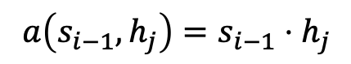
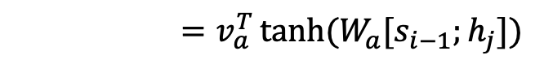
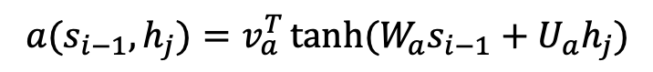
Various Attention Mechanism
$$s_{t}=f\left(s_{i−1}, y_{i−1},c_{t}\right)$$
$$c_{t}=\sum_{j=1}^{n}{α_{tj}h_{j}}$$
$$α_{ij}=\frac{exp⁡(e_{ij})}{\sum_{k=1}^{n}{exp⁡(e_{ik})}}$$
$$e_{ij}=a(s_{i−1},h_{j})$$
Additive Attention
$$a(s_{i−1},h_{j})=v_{a}^{T}\tanh{(W_{a}s_{i−1}+U_{a}h_{j})}$$
$=v_{a}^{T}\tanh{(W_{a}[s_{i−1};h_{j}])}$
Dot-Product Attention
$$a\left(s_{i−1},h_{j}\right)=s_{i−1}⋅h_{j}$$

Slide 91
Various Attention Mechanism
$$s_{t}=f\left(s_{i−1}, y_{i−1},c_{t}\right)$$
$$c_{t}=\sum_{j=1}^{n}{α_{tj}h_{j}}$$
$$α_{ij}=\frac{exp⁡(e_{ij})}{\sum_{k=1}^{n}{exp⁡(e_{ik})}}$$
$$e_{ij}=a(s_{i−1},h_{j})$$
Content-based Attention
Location-based Attention
General Attention

Slide 92
Various Attention Mechanism
Self Attention?

Slide 93
Various Attention Mechanism
Self Attention?
기존의 Attention은 target에 대해서 Source들과의 중요도를 계산

Slide 94
Various Attention Mechanism
Self Attention?
기존의 Attention은 target에 대해서 Source들과의 중요도를 계산
Self Attention은 Source끼리 중요도를 계산

Slide 95
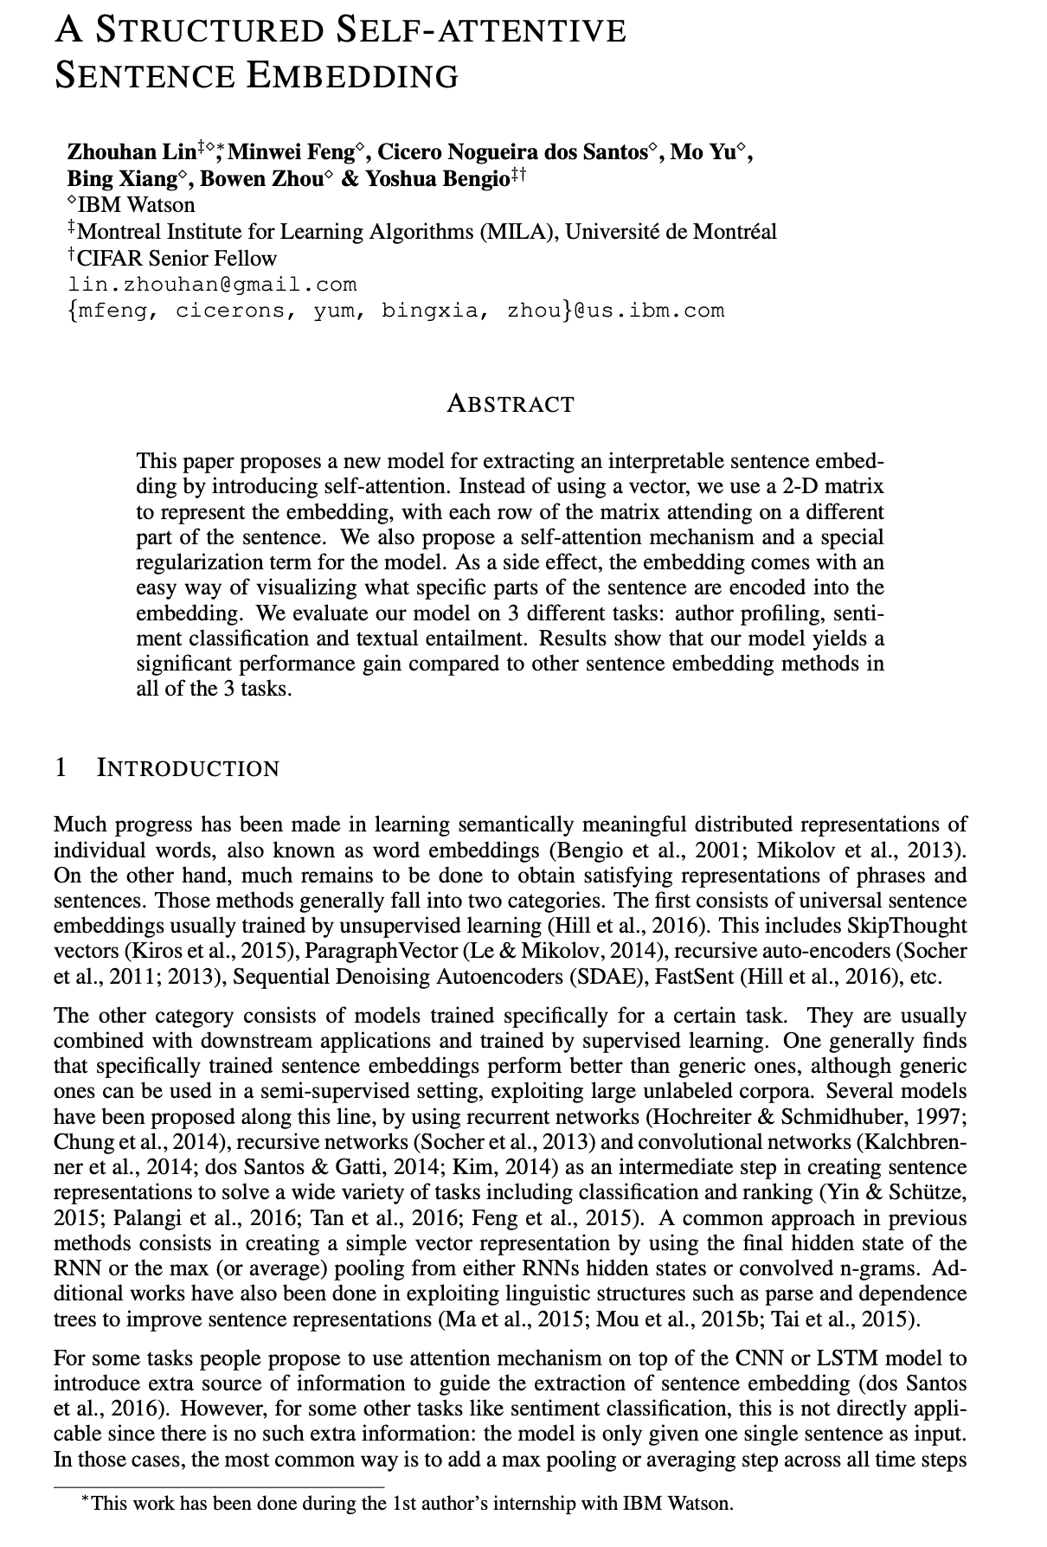
Structured Self-Attentive Sentence Embedding

Slide 96
Structured Self-Attentive Sentence Embedding
Zhouhan et al. (2016)

Slide 97
Structured Self-Attentive Sentence Embedding
Zhouhan et al. (2016)
Sentence 단위를 Embedding하기 위한 기법

Slide 98
Structured Self-Attentive Sentence Embedding
Zhouhan et al. (2016)
Sentence 단위를 Embedding하기 위한 기법
Sentence 내의 관계를 파악하기 위해 Self Attention 사용

Slide 99
Structured Self-Attentive Sentence Embedding
Zhouhan et al. (2016)
Sentence 단위를 Embedding하기 위한 기법
Sentence 내의 관계를 파악하기 위해 Self Attention 사용
Auto profiling, Sentiment Analysis, NLI Task에 적용

Slide 100
Structured Self-Attentive Sentence Embedding
Zhouhan et al. (2016)
Sentence 단위를 Embedding하기 위한 기법
Sentence 내의 관계를 파악하기 위해 Self Attention 사용
Auto profiling, Sentiment Analysis, NLI Task에 적용
Text Classification Task중 하나, 주어진 글 작성자의 정보를 예측

Slide 101
Structured Self-Attentive Sentence Embedding
Zhouhan et al. (2016)
Sentence 단위를 Embedding하기 위한 기법
Sentence 내의 관계를 파악하기 위해 Self Attention 사용
Auto profiling, Sentiment Analysis, NLI Task에 적용
Text Classification Task중 하나, 주어진 글 작성자의 정보를 예측
해당 논문에서는 Twitter dataset으로 작성자의 나이를 예측

Slide 102
Structured Self-Attentive Sentence Embedding

Slide 103

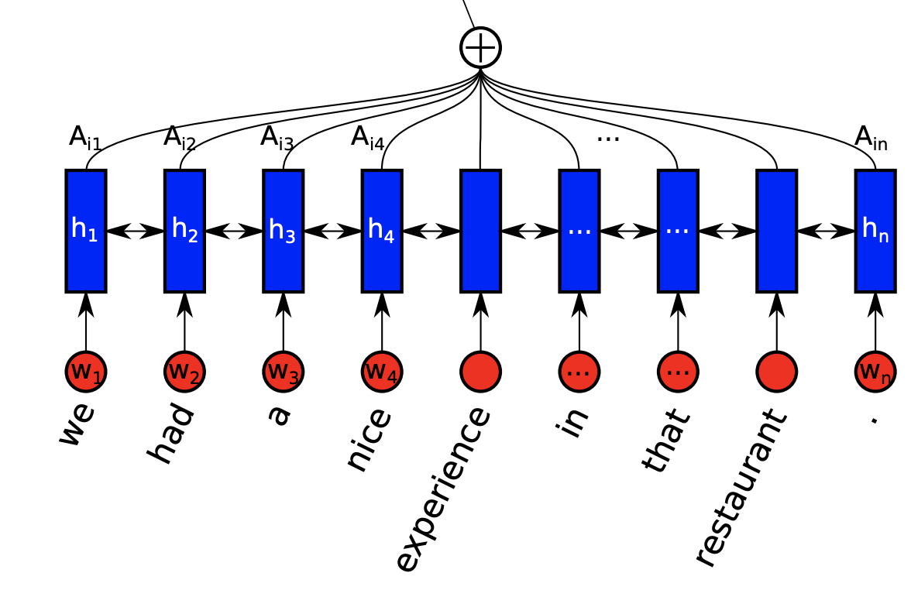
Structured Self-Attentive Sentence Embedding

Slide 104
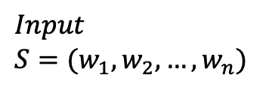
Structured Self-Attentive Sentence Embedding
$$Input$$
$$S=(w_{1}, w_{2}, …, w_{n})$$

Slide 105
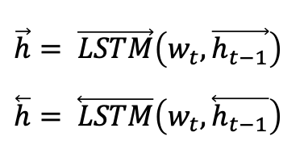
Structured Self-Attentive Sentence Embedding
$$Input$$
$$S=(w_{1}, w_{2}, …, w_{n})$$
$$\vec{h}= \vec{LSTM}\left(w_{t}, \vec{h_{t−1}}\right)$$
$$\overset{⃖}{h}= \overset{⃖}{LSTM}\left(w_{t},\overset{⃖}{h_{t−1}}\right)$$

Slide 106
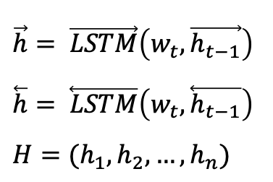
Structured Self-Attentive Sentence Embedding
$$Input$$
$$S=(w_{1}, w_{2}, …, w_{n})$$
$$\vec{h}= \vec{LSTM}\left(w_{t}, \vec{h_{t−1}}\right)$$
$$\overset{⃖}{h}= \overset{⃖}{LSTM}\left(w_{t},\overset{⃖}{h_{t−1}}\right)$$
$$H=(h_{1}, h_{2}, …, h_{n})$$

Slide 107
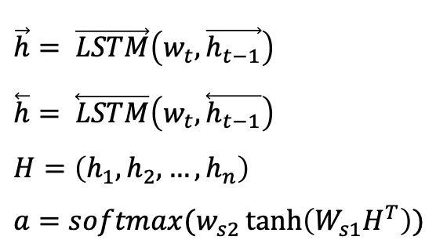
Structured Self-Attentive Sentence Embedding
$$Input$$
$$S=(w_{1}, w_{2}, …, w_{n})$$
$$\vec{h}= \vec{LSTM}\left(w_{t}, \vec{h_{t−1}}\right)$$
$$\overset{⃖}{h}= \overset{⃖}{LSTM}\left(w_{t},\overset{⃖}{h_{t−1}}\right)$$
$$H=\left(h_{1}, h_{2}, …, h_{n}\right)$$
$$a=softmax(w_{s2}\tanh\left(W_{s1}H^{T}\right))$$

Slide 108
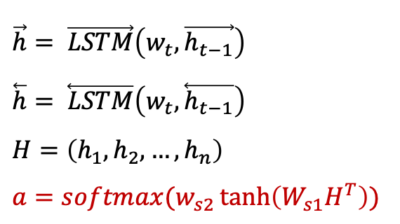
Structured Self-Attentive Sentence Embedding
$$Input$$
$$S=(w_{1}, w_{2}, …, w_{n})$$
$$\vec{h}= \vec{LSTM}\left(w_{t}, \vec{h_{t−1}}\right)$$
$$\overset{⃖}{h}= \overset{⃖}{LSTM}\left(w_{t},\overset{⃖}{h_{t−1}}\right)$$
$$H=\left(h_{1}, h_{2}, …, h_{n}\right)$$
$$a=softmax(w_{s2}\tanh\left(W_{s1}H^{T}\right))$$
Self Attention

Slide 109
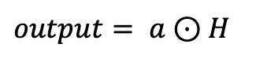
Structured Self-Attentive Sentence Embedding
$$Input$$
$$S=(w_{1}, w_{2}, …, w_{n})$$
$$\vec{h}= \vec{LSTM}\left(w_{t}, \vec{h_{t−1}}\right)$$
$$\overset{⃖}{h}= \overset{⃖}{LSTM}\left(w_{t},\overset{⃖}{h_{t−1}}\right)$$
$$H=\left(h_{1}, h_{2}, …, h_{n}\right)$$
$$a=softmax(w_{s2}\tanh\left(W_{s1}H^{T}\right))$$
$$output= a⊙H$$

Slide 110
Another methods to enrich NMT performance

Slide 111
Another methods to enrich NMT performance

Slide 112
Another methods to enrich NMT performance
Teacher Forcing
Beam Search

Slide 113
Another methods to enrich NMT performance
Teacher Forcing

Slide 114
Another methods to enrich NMT performance
Teacher Forcing
Prediction: W, X, Y, Z

Slide 115
Another methods to enrich NMT performance
Teacher Forcing
Prediction: W, X, Y, Z
Label: ?

Slide 116
Another methods to enrich NMT performance
Teacher Forcing
Prediction: W, X, Y, Z
Label: W, X, Y, Z

Slide 117
Another methods to enrich NMT performance
Teacher Forcing
Prediction: W, X, Y, Z
Label: W, X, Y, Z
Ideal case!

Slide 118
Another methods to enrich NMT performance
Teacher Forcing
Prediction: W, X, Y, Z
Label: W, X, K, N

Slide 119
Another methods to enrich NMT performance
Teacher Forcing
Prediction: W, X, Y, Z
Label: L, M, O, Q

Slide 120
Another methods to enrich NMT performance
Teacher Forcing
Prediction: W, X, Y, Z
Label: Q, Q, Q, Q

Slide 121
Another methods to enrich NMT performance
Teacher Forcing
Prediction: W, X, Y, Z
Label: Q, Q, Q, Q
It is hard to converge!

Slide 122
Another methods to enrich NMT performance
Teacher Forcing
일정 확률로 이전 step의 output 대신 실제 해당 step의 label값을 넣어준다.

Slide 123
Another methods to enrich NMT performance
Teacher Forcing

Slide 124
Another methods to enrich NMT performance
Teacher Forcing
Label: W, K, X, Z

Slide 125
Another methods to enrich NMT performance
Teacher Forcing
W
Label: W, K, X, Z

Slide 126
Another methods to enrich NMT performance
Teacher Forcing
W
W
Label: W, K, X, Z

Slide 127
Another methods to enrich NMT performance
Teacher Forcing
W
Z
W
Label: W, K, X, Z

Slide 128
Another methods to enrich NMT performance
Teacher Forcing
W
Z
W
Z
Label: W, K, X, Z

Slide 129
Another methods to enrich NMT performance
Teacher Forcing
W
Z
W
K
Label: W, K, X, Z

Slide 130
Another methods to enrich NMT performance
Teacher Forcing
W
Z
Y
W
K
Label: W, K, X, Z

Slide 131
Another methods to enrich NMT performance
Teacher Forcing
W
Z
Y
W
K
Y
Label: W, K, X, Z

Slide 132
Another methods to enrich NMT performance
Teacher Forcing
W
Z
Y
W
K
Y
Label: W, K, X, Z

Slide 133
Another methods to enrich NMT performance
Teacher Forcing
W
Z
Y
M
W
K
Y
Label: W, K, X, Z

Slide 134
Another methods to enrich NMT performance
Teacher Forcing
W
Z
Y
M
W
K
Y
M
Label: W, K, X, Z

Slide 135
Another methods to enrich NMT performance
Teacher Forcing
W
Z
Y
M
W
K
Y
M
Label: W, K, X, Z

Slide 136
Another methods to enrich NMT performance
Teacher Forcing
W
Z
Y
M
W
K
Y
Z
Label: W, K, X, Z

Slide 137
Another methods to enrich NMT performance
Teacher Forcing
W
Z
Y
M
<EOS>
W
K
Y
Z
Label: W, K, X, Z

Slide 138
Another methods to enrich NMT performance
Beam Search
기존의 greedy한 방법의 decoding 방식의 대안

Slide 139
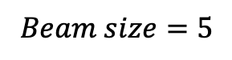
Another methods to enrich NMT performance
Beam Search
$$Beam size=5$$

Slide 140
Another methods to enrich NMT performance
Beam Search
$$Beam size=5$$

Slide 141
Another methods to enrich NMT performance
Beam Search
$$Beam size=5$$

Slide 142
Another methods to enrich NMT performance
Beam Search
$$Beam size=5$$

Slide 143
Another methods to enrich NMT performance
Beam Search
$$Beam size=5$$

Slide 144
Another methods to enrich NMT performance
Beam Search
$$Beam size=5$$

Slide 145
Another methods to enrich NMT performance
Beam Search
$$Beam size=5$$

Slide 146
Another methods to enrich NMT performance
Beam Search
$$Beam size=5$$

